Slide 1
Debugging
Notes:
Welcome to session 4 – unit testing in python

Slide 2
Learning Outcomes
1. Understand and apply best practices for debugging in Python, including recognising different types of errors and their corresponding messages.
2. Gain practical experience in identifying and fixing intentional bugs in provided code samples.
3. Learn when and how to use various debugging approaches, including when to use tools like the VS Code debugger, when to add logging, and when to seek help appropriately.
4. Develop skills in implementing error handling and logging in Python code and understand the importance of these practices.
5. Recognise the importance of code refactoring and writing tests after fixing bugs to prevent future occurrences and improve code quality.

Slide 3
Introduction to Debugging
Debugging is the process of finding and fixing errors in code
Essential skill for all developers
Improves code quality and reliability
Can be proactive or reactive

Slide 4
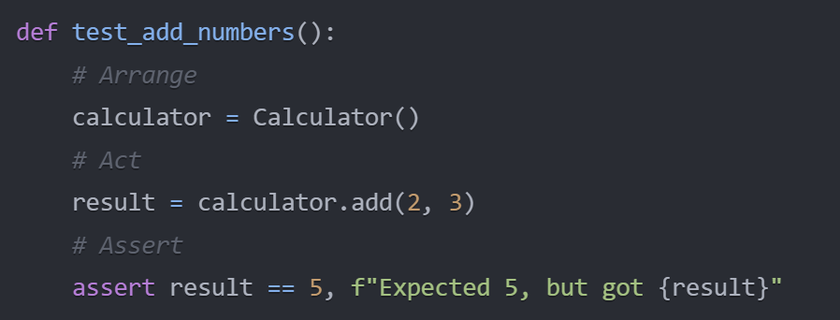
Debugging in the Context of AAA and TDD
AAA: Arrange, Act, Assert
TDD: Test-Driven Development
Tests provide a framework for debugging
Failed tests pinpoint where to start debugging

Slide 5
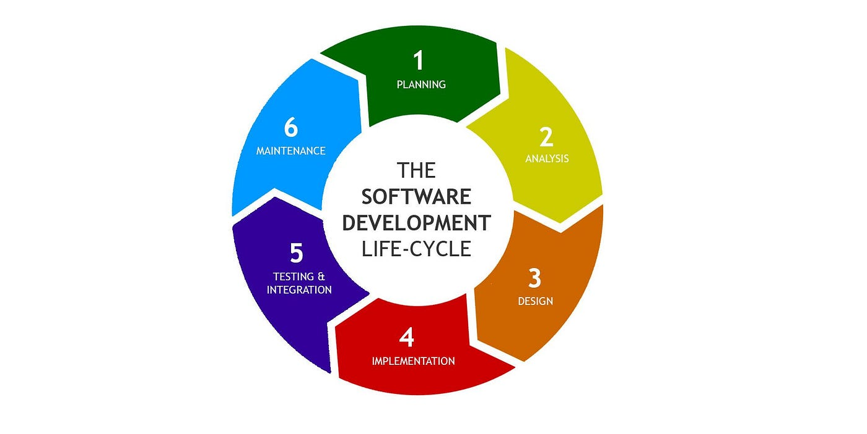
When to Debug
During TDD cycle (when tests fail)
After implementing new features
In response to reported issues
During code reviews

Slide 6
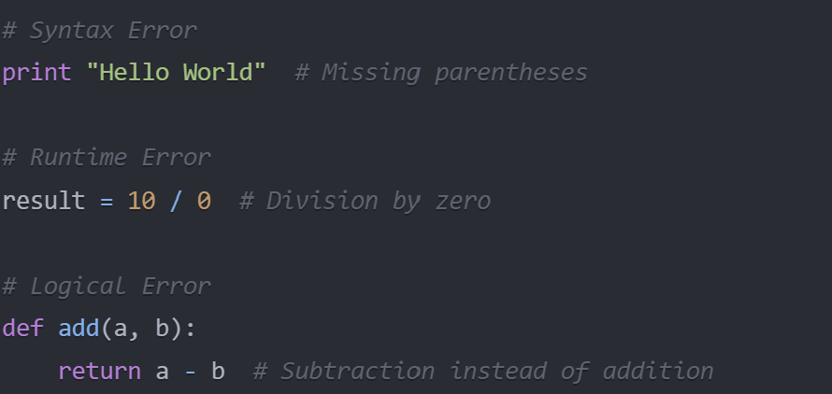
Types of Errors in Python
Syntax Errors: Invalid Python code
Runtime Errors: Occur during program execution
Logical Errors: Code runs but produces incorrect results
Each type requires different debugging approaches

Slide 7
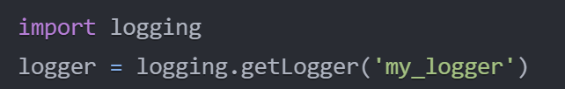


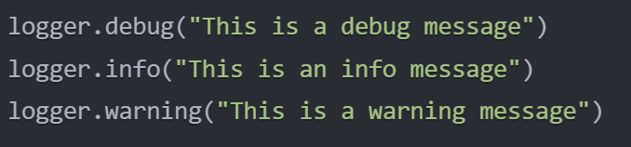
Key Debugging Functions in Python
Creates a custom logger object
Setting Log Levels - Sets the minimum severity of messages to log - Levels: DEBUG, INFO, WARNING, ERROR, CRITICAL
Creating File Handlers
Formatting Log Messages
Adding Handlers to Logger
Logging Messages

Slide 8
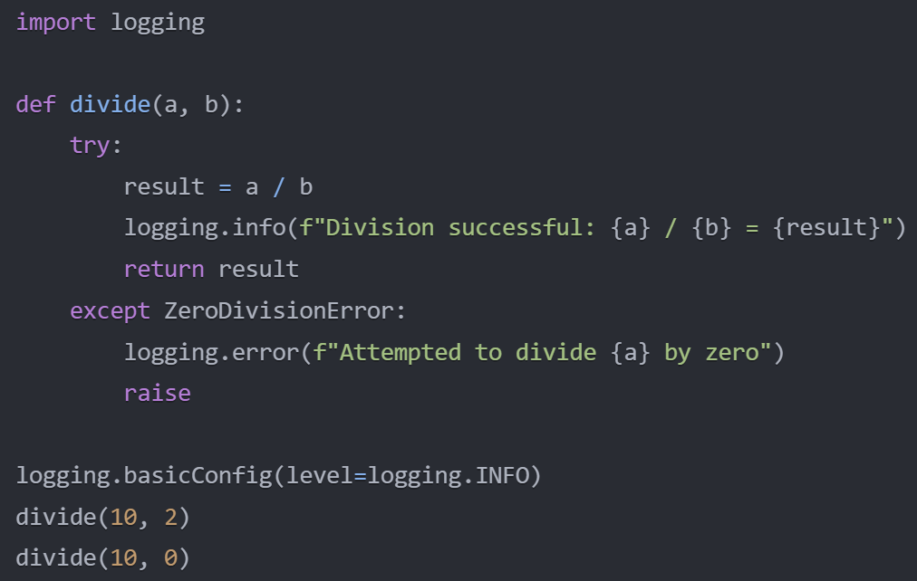
Debugging Best Practices
Read and understand error messages
Use print statements strategically
Utilize debugging tools (e.g., VS Code debugger)
Implement logging
Leverage unit tests for debugging

Slide 9
Exercise 1: Debugging with Error Logging
https://github.com/Gromm21xx/debugging.git

Slide 10
Exercise 2: Bug Hunt and Fix
https://github.com/Gromm21xx/debugging.git

Slide 11
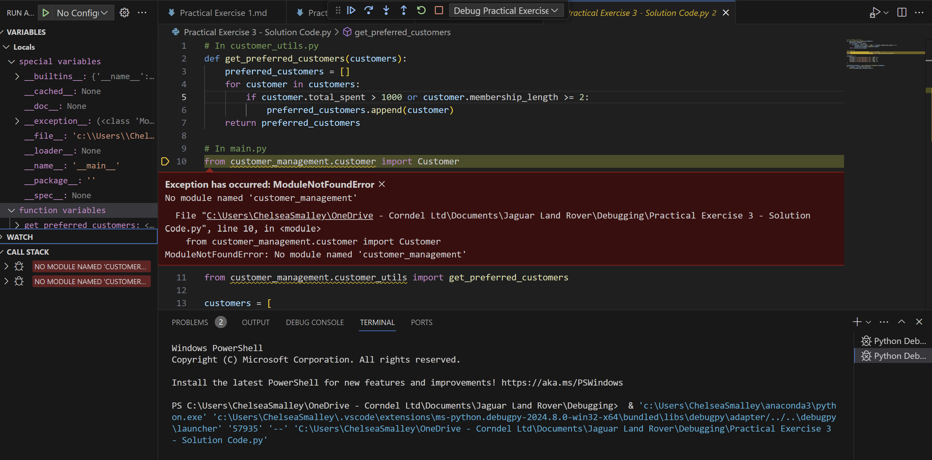
Debugging in Visual Studio Code
Set breakpoints
Use the Debug Console
Inspect variables
Step through code
Use the Watch window

Slide 12
Exercise 3: Debugging with VS Code
https://github.com/Gromm21xx/debugging.git

Slide 13
Stretch Exercise - Advanced Debugging with Concurrency
https://github.com/Gromm21xx/debugging.git

Slide 14
CHEAT SHEET
Logging
logging.basicConfig(level=logging.INFO, format='%(asctime)s - %(levelname)s - %(message)s')
Debugger
Set breakpoint: breakpoint() or import pdb; pdb.set_trace()
Print Debugging
Print variable state: print(f"Variable x: {x}")
Exception Handling
Try-except block: try: ... except Exception as e: print(f"Error: {e}")
Assertions
Assert condition: assert condition, "Error message if condition is False"
VS Code Debugging
Start debugger: F5 key or Run > Start Debugging

Slide 15
Feedback Survey
https://forms.office.com/e/GAEZ93D1yj

Slide 16
Thank you

